Slide 1

Employee Data Analysis Using Excel
NAME : VINUSHA DHANAPAL
REG NO:2213371036155
NAN MUDHALVAN ID : D25D4EEBB2E0310BC3D4AD51D48AF14D DEPARTMENT : B.COM
COLLAGE NAME : QUAID E MILLATH GOVERNMENT COLLAGE FOR WOMEN ( AUTONOMUS)

Slide 2
Project Title
Employee Performance Analysis Using Excel

Slide 3


Agenda
1.Problem Statement
2.Project Overview
3.End Users
4.Our Solution and Proposition
5. Dataset Description
6.Modelling Approach
7.Results and Discussion
8.Conclusion

Slide 4
Problem
Statement
Inconsistent Evaluations: Employees feel frustrated by the uneven and sometimes unfair performance reviews across different teams.
Infrequent Feedback: Many employees are struggling because they only get feedback once a year, missing out on timely guidance and support.
Misaligned Goals: Employees find it challenging to see how their work fits into the company's big picture, leading to confusion and lack of focus.

Slide 5
Our goal is to use data to better understand and improve employee performance, boost satisfaction, and make sure everyone’s goals align with the company’s mission.
Data-driven insights support better decisions on promotions, compensation, and professional development.
Project
Overview
Improved identification of high performers and areas for growth leads to better talent management.
Clear, consistent feedback helps employees understand their impact on organizational goals, boosting engagement.

Slide 6







Managers and Team Leads
They will use the dashboard and reports to monitor team performance, provide feedback, and make decisions about promotions and development.
Who Are The End Users ?
HR Professionals
They will leverage the insights and recommendations to refine performance management processes, design training programs, and address organizational goals.
Employees
They will review high-level analysis reports to align employee performance with strategic objectives and make informed decisions about company-wide policies and resource allocation.

Slide 7

Our Solution And Its Value Proposition
Conditional Formatting
To Highlight Missing Value
Filter
To Remove Missing Value
Formula
To Calculate Performance Level
Pivot Table
Summary
Graph
Data Visualization

Slide 8
Dataset Desciption
Employee | Kaggle
Features Available | 26
Features Used | 9
Employee ID | Numerical Value
Employee Name | Text
Employee Type | Full Time/Part-time/Contract
Performance Level | Low/Med/High/Very High
Gender | Male/Female
Employee Rating | 1-5
Business Unit | Text

Slide 9
The “WOW” In Our Solution
What really stands out is how the feedback and development plans are personalized. It feels like the system truly understands each employee’s unique needs and helps them grow in the right direction.

Slide 10
Data Collection
Access the Kaggle account with the appropriate username and password.
Navigate to the “Data” or “Reports” section, choose the required dataset, and click the “Download” button.
Select the desired file format (e.g., CSV or Excel) and save the file to the computer.
Feature Collection
Determine all relevant data sources and systems from which features will be collected.
Identify and define the specific features or attributes needed for analysis, such as performance metrics, Performance records, and Performance scores.
Modelling
Data Cleaning
Filtered out the required data
Performance Level
Performance level is calculated based on the performance score
Level of performance of each employees were calculated and output is obtained.
Summary
Pivot Table is made for the data obtained
Graph showing the data of employee performance is made
This report focuses on collecting key features needed for analysis. It involves identifying relevant data sources, defining important attributes like performance metrics and feedback, and integrating this data into a cohesive format for accurate and insightful analysis.

Slide 11

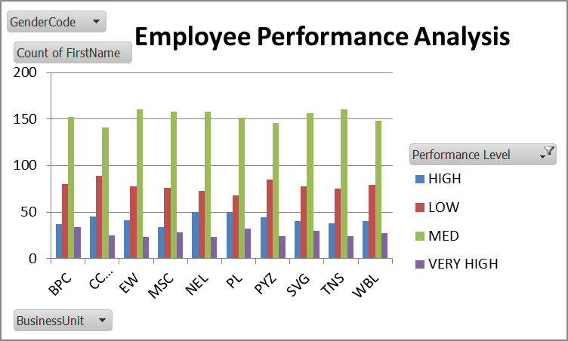
Results
Gender Code | (All)
Count of FirstName | Column Labels
Row Labels | HIGH | LOW | MED | VERY HIGH | Grand Total
BPC | 37 | 80 | 152 | 34 | 303
CCDR | 45 | 89 | 141 | 25 | 300
EW | 41 | 78 | 160 | 23 | 302
MSC | 34 | 76 | 158 | 28 | 296
NEL | 50 | 73 | 158 | 23 | 304
PL | 50 | 68 | 151 | 32 | 301
PYZ | 44 | 85 | 146 | 24 | 299
SVG | 40 | 78 | 156 | 30 | 304
TNS | 38 | 75 | 160 | 24 | 297
WBL | 40 | 79 | 148 | 27 | 294
Grand Total | 419 | 781 | 1530 | 270 | 3000

Slide 12
Conclusion
Data Collected: Essential features from various sources have been gathered.
Metrics Set: Key performance metrics have been clearly defined.
Data Integrated: All data is now in a unified format.
Ready for Analysis: We’re set to start analyzing and making informed decisions.

